Slide 1
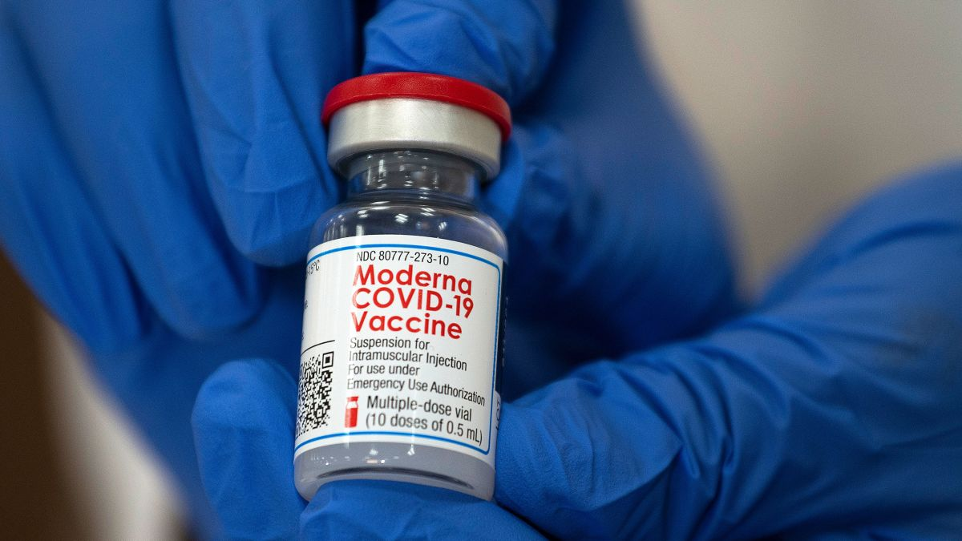
Investigating COVID Vaccination Data
DCSI 521 Final Project Presentation
Group 4: Zach Carlson, Julie Scheffler,
Srijan Pandey, Fernando Ramirez

Slide 2
AGENDA
Project Overview
COVID Overview
Overview of Data Used
Data Analysis:
Red States v. Blue States
Partial v. Fully Vaccinated
Election Trends
Manufacturer Data
Known Limitations of Project
Potential Future Development

Slide 3
AGENDA
Project Overview
COVID Overview
Overview of Data Used
Data Analysis:
Red States v. Blue States
Partial v. Fully Vaccinated
Election Trends
Manufacturer Data
Known Limitations of Project
Potential Future Development

Slide 4
Intro: Project Overview
Our analysis will focus on COVID vaccination data provided by Our World in Data (https://github.com/owid/covid-19-data/tree/master/public/data/vaccinations).
Questions:
Are there correlation of US states and last presidential election and distribution of vaccines?
What do partially and fully vaccinated rates tell us? Can we draw any insights?
How is COVID spreading world-wide in comparison to vaccination? What sources are cited to report these vaccination rates?
Audience
We hope to generate guidance and draw insights to assist further pandemic research and epidemiology

Slide 5
AGENDA
Project Overview
COVID Overview
Overview of Data Used
Data Analysis:
Red States v. Blue States
Partial v. Fully Vaccinated
Election Trends
Manufacturer Data
Known Limitations of Project
Potential Future Development

Slide 6
COVID Overview
Currently there are over 141 million COVID infections and over 3 million death due to COVID [2]
This analysis will give us a statistical look into vaccination efforts in the US and try to explain sentiments regarding the pandemic
Furthermore, our analysis will try to address questions asked by researched to pre-emptively take actions.
Future considerations would be having a developed analysis with open-accessibility to communicate the state of living to the general public and health professionals alike.

Slide 7
AGENDA
Project Overview
COVID Overview
Overview of Data Used
Data Analysis:
Red States v. Blue States
Partial v. Fully Vaccinated
Election Trends
Manufacturer Data
Known Limitations of Project
Potential Future Development

Slide 8
Overview of Data Used
COVID Vaccination Data came from Our World in Data (OWID) and was downloaded from their public Github repository.
Presidential election Data from 1976-2020 came from the M.I.T. Election Data and Science Lab and the file was called 1976-2020-president.tab.

Slide 9
AGENDA
Project Overview
COVID Overview
Overview of Data Used
Data Analysis:
Red States v. Blue States
Partial v. Fully Vaccinated
Election Trends
Manufacturer Data
Known Limitations of Project
Potential Future Development

Slide 10
Red States v. Blue States
Hypothesis: Considering how COVID and its vaccine have been politicized, do red (i.e. Republican) states have different vaccinate rates compared to blue (i.e. Democratic states?)
Combined the OWID data and M.I.T. election data.
Gave each state a political metric.
Adjusted metric using weights.

Slide 11
Political Metric
Problem: cannot sort each state based off last election, considering there were swing states.
Solution: Utilize historical election data to accurately sort states.
Gave each state a score based off the election results from 1976-2020.
If state voted majority Democratic -> added a -1 to metric.
If state voted majority Republican -> added a 1 to metric.
If a state was greater than 0, it mostly voted Republican
If a state was less than 0, it mostly voted Democratic

Slide 12
Political Metric, Optimized
Problem: The political metric equation equally values the 1976 results to 2020, making California a neutral state, when it is in fact very blue.
Solution: apply weights to each election year
Applied weights ranging from 0.01 (for 1976) to 1 (for 2020) to prioritize more recent elections over old elections.

Slide 13
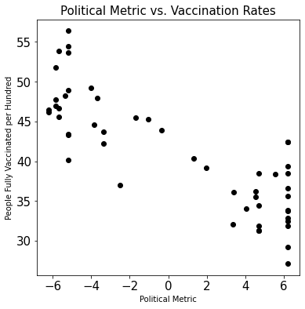
Results
Using a scatter plot, a negative trend is shown where the higher the political metric (i.e. the more historically red), the lower the vaccinate rate.

Slide 14
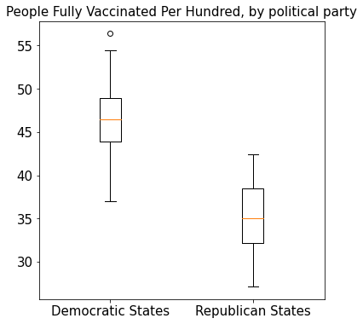
Results
****
Simplified version of scatter plot, data for June 1st, 2021.
Democratic States had political metric < 0
Republican States had political metric > 0
Using an independent two-sided t-test, the p-value < 10⁻¹³

Slide 15
AGENDA
Project Overview
COVID Overview
Overview of Data Used
Data Analysis:
Red States v. Blue States
Partial v. Fully Vaccinated
Election Trends
Manufacturer Data
Known Limitations of Project
Potential Future Development

Slide 16
Partially v. Fully Vaccinated
Hypothesis: People are skipping the second vaccine dose.
Combined the US Vaccination Data and the Manufacturer Data

Slide 17
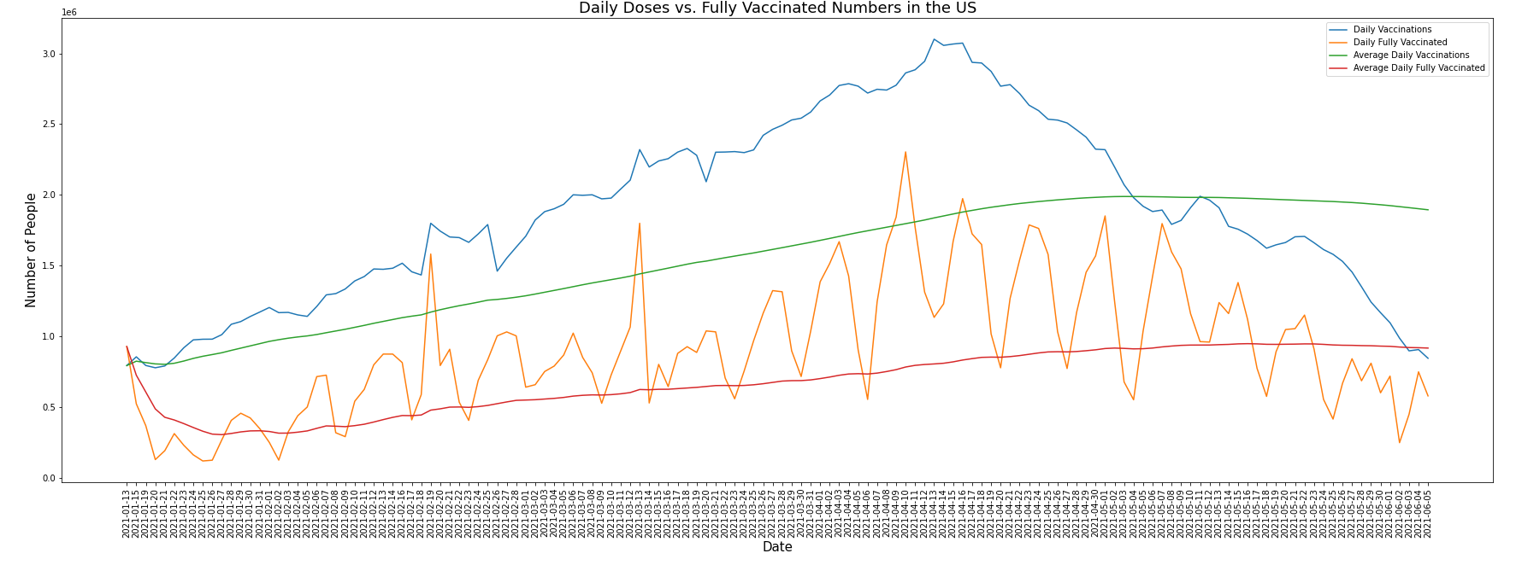
Doses vs. Fully Vaccinated - Raw

Slide 18
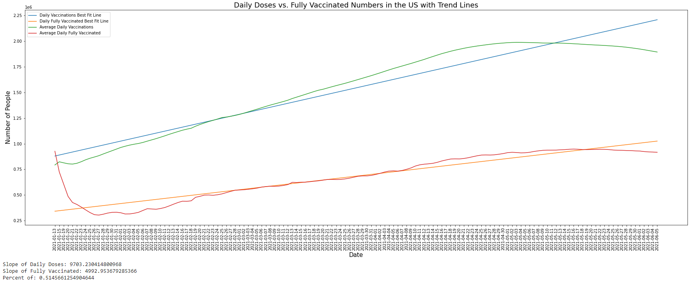
Doses vs. Fully - Trend Lines

Slide 19
Doses vs. Fully - Trend Lines
Slope of Daily Vaccination Doses: 9703.230414800968
Slope of Daily Fully Vaccinated Rate: 4992.953679285366
Percent Fully/Daily: 0.5145661254904644
Expectation for perfect dosage distribution would be perfect 50%
Factors that would affect this simple calculation:
Not all vaccines given out, require two doses
The time required between the two doses is always the same
Assumes no person skipped the second shot

Slide 20
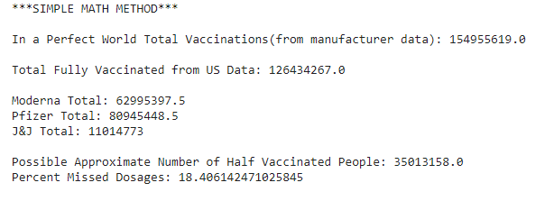
Simple Math - 2 Dose Vaccines
Combining Manufacturing Data and US Vaccination Data
Subtraction of total predicted vaccine - actual fully vaccinated
April CDC paper says approximately 8% of 2nd doses missed.

Slide 21
Refining
Actions
Removing J&J vaccinations because single dose
Predicting 2nd dose date using known number of days between doses
Using 2nd dose date to predict expected number of vaccinations on which day
Removing data from beginning that is not totally accounted for
Problems
The dose numbers and dates were not lining up
There was a obvious delay in the data
Could not pursue further without more data.

Slide 22
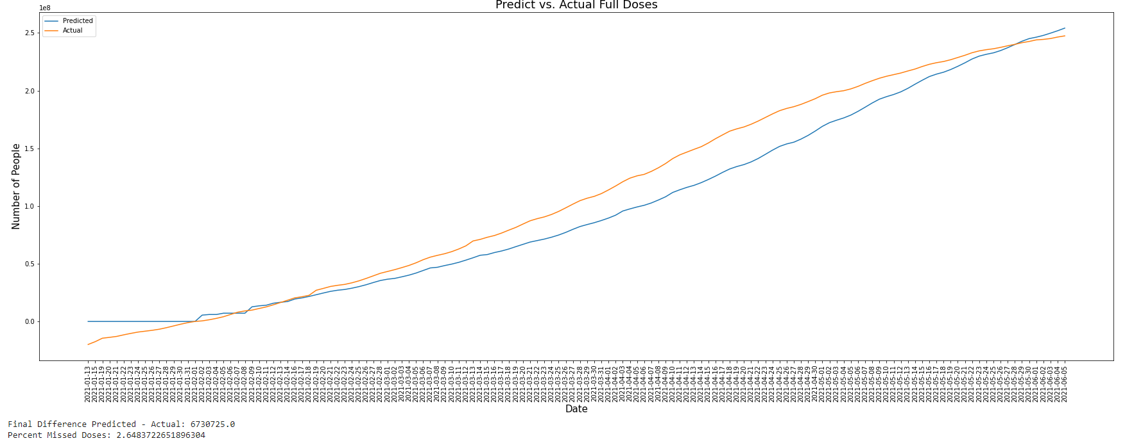
Evidence of Problem
Actual higher than predicted.

Slide 23
AGENDA
Project Overview
COVID Overview
Overview of Data Used
Data Analysis:
Red States v. Blue States
Partial v. Fully Vaccinated
Election Trends
Manufacturer Data
Known Limitations of Project
Potential Future Development

Slide 24
Historical and Current Election Trends
We wanted to know what are the election trends in different states.
We wanted to understand what kind of political leaning a particular states have both currently and in the past.
One reason we wanted to look at past records, was to see if a particular states are swing states.
This gives us an idea about whether a state is strictly convervative, in the middle or strictly liberal state.

Slide 25
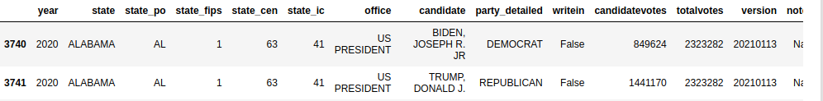
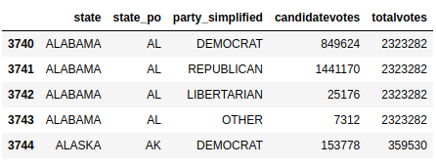
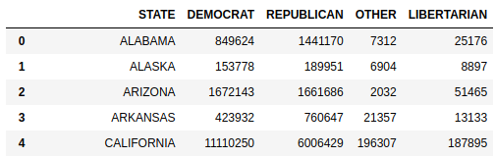
Identifying Number of Votes:
We had to come up of a way to preprocess and reduce the initial data to create meaningful dataset.
We used sequence of transformation operations such as fillnas, aggregations and filters to come up with votes for individual parties.

Slide 26
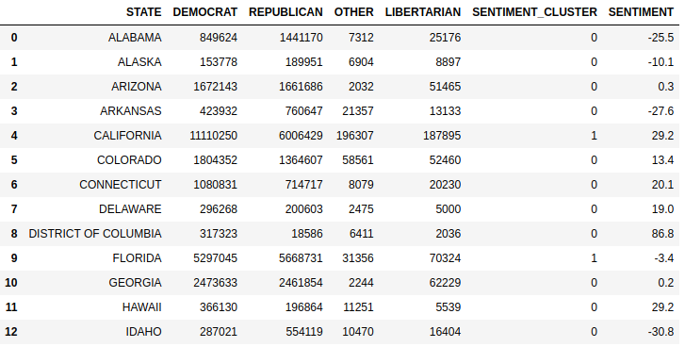
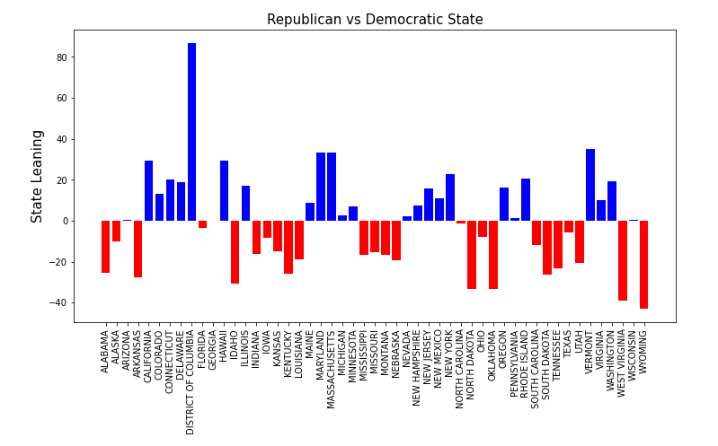
2020 State Political Leaning
Above we built a simple model to identify how democratic or republican leaning a state was in 2020. We use values from -100 to 100. A value of -100 would indicate that the state is absolutely republican leaning and a value of 100 would mean a state is completely democratic leaning.

Slide 27
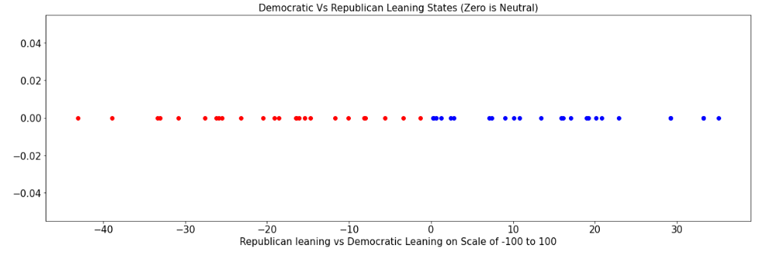
2020 States Political Leaning Look

Slide 28
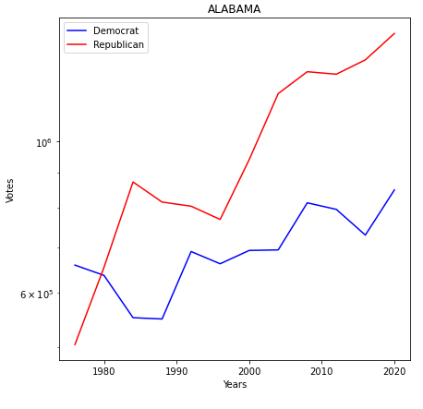
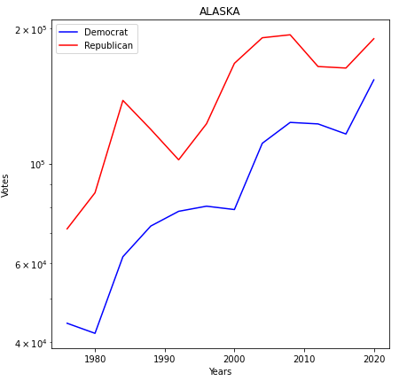
Previous Trends in Election
We also wanted to look into the kind of historical leaning a particular state has?
Are political leaning of a state fixed or is easily changed were some questions we wanted to answer.
We used time series analysis techniques to answer these questions.
Strictly Conservative States Trends

Slide 29
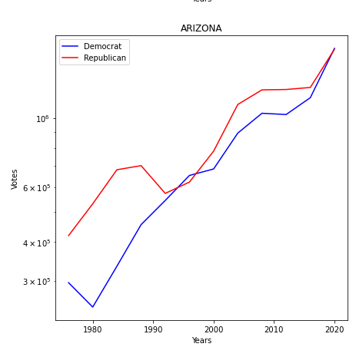
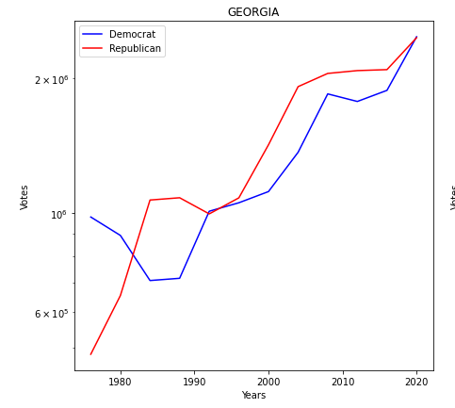
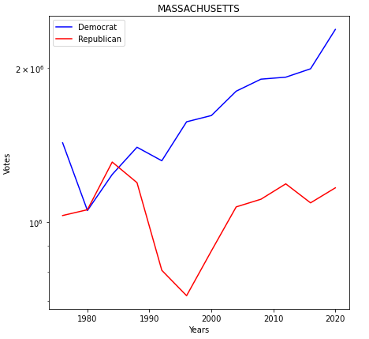
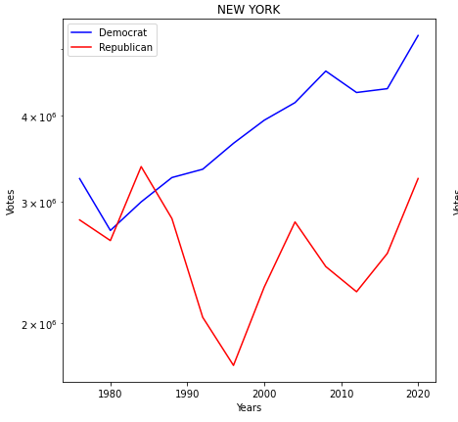
2020 States a Leaning Look
Swing States Trends
Liberal States Trends
See trends for all states in our Jupyter Notebook

Slide 30
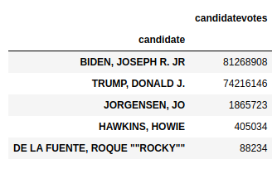
Other 2020 Election Insight
Most Voted Candidates
Which states value your political opinions the most?

Slide 31
AGENDA
Project Overview
COVID Overview
Overview of Data Used
Data Analysis:
Red States v. Blue States
Partial v. Fully Vaccinated
Election Trends
Manufacturer Data
Known Limitations of Project
Potential Future Development

Slide 32
Manuf & World Vaccinations
Hypothesis: Considering the vast majority of countries (excluding the US, China. etc) do not have as such readily available vaccines, how is reporting total vaccinations going?
Manufactures
Sources for tracking vaccinations
Total Vaccinations & percentages of weekly death growth

Slide 33
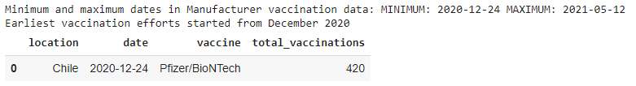
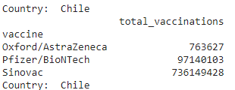
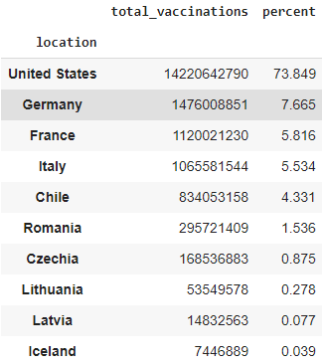
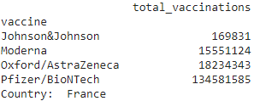
Manuf & World Vaccinations Cont.
C.
B.
D.
Overall we see drastic difference from the number of United States vaccinations from 73.5% to the next leading country Germany with 7.5% of the total population (assumed) to be vaccinated

Slide 34
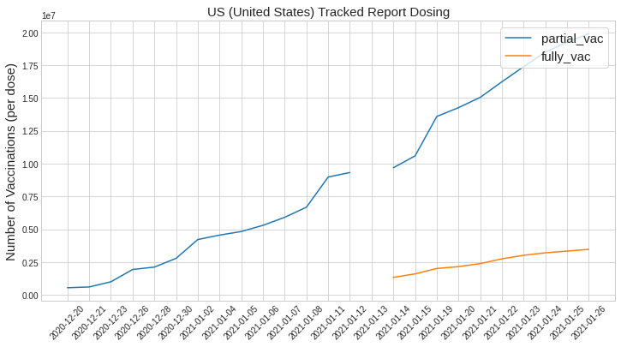
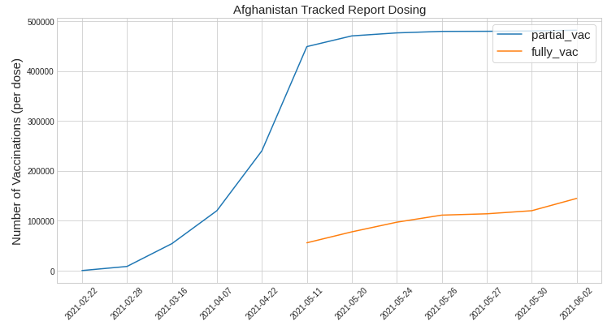
Manuf & World Vaccinations Cont.
US compared to Afghanistan we see the discrepancies in mediums of tracking dosing and the robustness of healthcare. This may do to complex multifactorial & multi-ethnic factors.

Slide 35

Manuf & World Vaccinations Cont.
Future investigation should be pursued of how standard reporting of vaccinations and percentages of weekly death rates are compiled

Slide 36
AGENDA
Project Overview
COVID Overview
Overview of Data Used
Data Analysis:
Red States v. Blue States
Partial v. Fully Vaccinated
Election Trends
Manufacturer Data
Known Limitations of Project
Potential Future Development

Slide 37
Known Limitations
Red v. Blue States: The data needs to be re-analyzed each day to get up-to-date results. The `date` must be manually changed, as well.

Slide 38
AGENDA
Project Overview
COVID Overview
Overview of Data Used
Data Analysis:
Red States v. Blue States
Partial v. Fully Vaccinated
Election Trends
Manufacturer Data
Known Limitations of Project
Potential Future Development

Slide 39
Potential Future Development
Red v. Blue States: look at the impact of senator/governor elections on vaccination counts. Combine these results with the presidential elections as well.
World: Investigate ongoing distribution of vaccinations as implementation for Global Vaccine Sharing starts
Election: Investigate trends in election and understand correlations between political opinion and world events

Slide 40
References
[1] https://github.com/owid/covid-19-data/tree/master/public/data/vaccinations
[2] https://coronavirus.jhu.edu/map.html)

